Slide 1
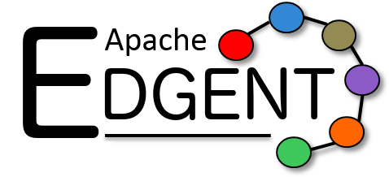

Introduction to Apache Edgent
Ryan Brown IBM

Slide 2
Sections
Intro to IoT
Edgent
Raspberry Pi Demo
Q&A

Slide 3
Edge Computing
Constrained by Cost, Storage, Environment, etc.
Limited Connectivity to Central Systems
Bandwidth
Connection type (cellular, WiFi, etc)
Signal loss
Composed of Local Sensors
Mobile or Static
Data Throughput Consists of Thousands or Millions of Devices

Slide 4
Edge Computing Examples
Vehicle:
Car, commercial truck, plane, drone...
Engine sensor data processed through central bus for potential failure
Mobile: possible signal failure
Building: HVAC, motion sensors, climate control…
Server: load, CPU temp, rack temp...
Smartphone

Slide 5
Why Compute on Edge Devices
Reduce Communication
Send relevant data when an event of interest occurs
Heartbeats may not contain enough data or be too late to take action
React Locally
More intelligent decision making
Execute analytics while disconnected
Collaborate with Related Devices
Learn from devices with similar characteristics
Group by location or use case

Slide 6
Edgent Application
Device Events
Central Analytics
IoT Message Hub
Device Commands
Archive

Slide 7
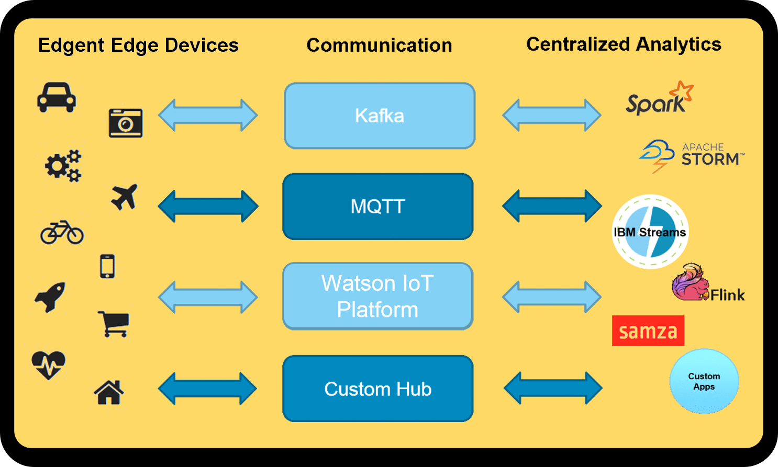

Slide 8
Device Model
Send Device Events to be Centrally Analyzed
Engine temp when overheating
GPS location change
Moisture sensor threshold met
Edgent application metrics
Receive Device Commands to Alter State
Reduce the max engine revs to reduce chance of failure
Ice ahead!
Increase or decrease poll of engine data

Slide 9
Single Topology
Sensor
Ingestion
Local
Analytics
IoT
Interface
Device Commands
Sensor
Device Commands
Possible single connection to IoT hub
Potential competition with multiple applications

Slide 10
Full Topology
Temp
Temp Monitor
Positional Analytics
Device Commands
Sensor
Proximity
IoT Interface
Device Commands
Wind
System Control
System
Monitor

Slide 11
Full Topology
Temp
Temp Monitor
Device Commands
Sensor
Proximity
Positional Analytics
IoT Interface
Device Commands
Wind
System Control
System
Monitor

Slide 12
Full Topology Uses
Enable / disable pre-installed features
Diagnose transient problems
Composite local analytics
Send enriched data to IoT hub
Address locally competing resources

Slide 13
Edgent
Functional flow: Map, Flatmap, Agg, Split, Union, etc
Windowing
Messaging connections and datastores
Kafka
JDBC
HTTP
Websockets
IBM Watson IoT Platform
Micro-kernel style runtime, minimal footprint

Slide 14
Features
Java 8 temps = temps.filter( t -> t > 35)
Apache Commons Math 3
Windowed aggregates: MAX, MIN, SUM, STDDEV, etc
K-Means clustering
Deadbanding

Slide 15
Deadbanding
temps = deadband( temps,
j -> getDouble( j, “value” ),
v -> v > 5.0 && v <= 25.0,
20, SECONDS );

Slide 16
IoT vs Big Data
Big Data => storage, parallelization, data
Semi-centralized
Trends, global analytics
Visualiztions
IoT => throughput, connectivity, data
Independence
Aggregates => Big Data

Slide 17
Raspberry Pi Edgent Demo
Register device at IBM Watson IoT Platform
Create local config file
Fork and download Edgent from Git
Import into Eclipse / Intellij and build via Gradle
Create Demo project and import dependencies
Make runnable jar
Configure XQuartz / X11
scp jar and config file to Pi
ssh to Pi and run the jar

Slide 18
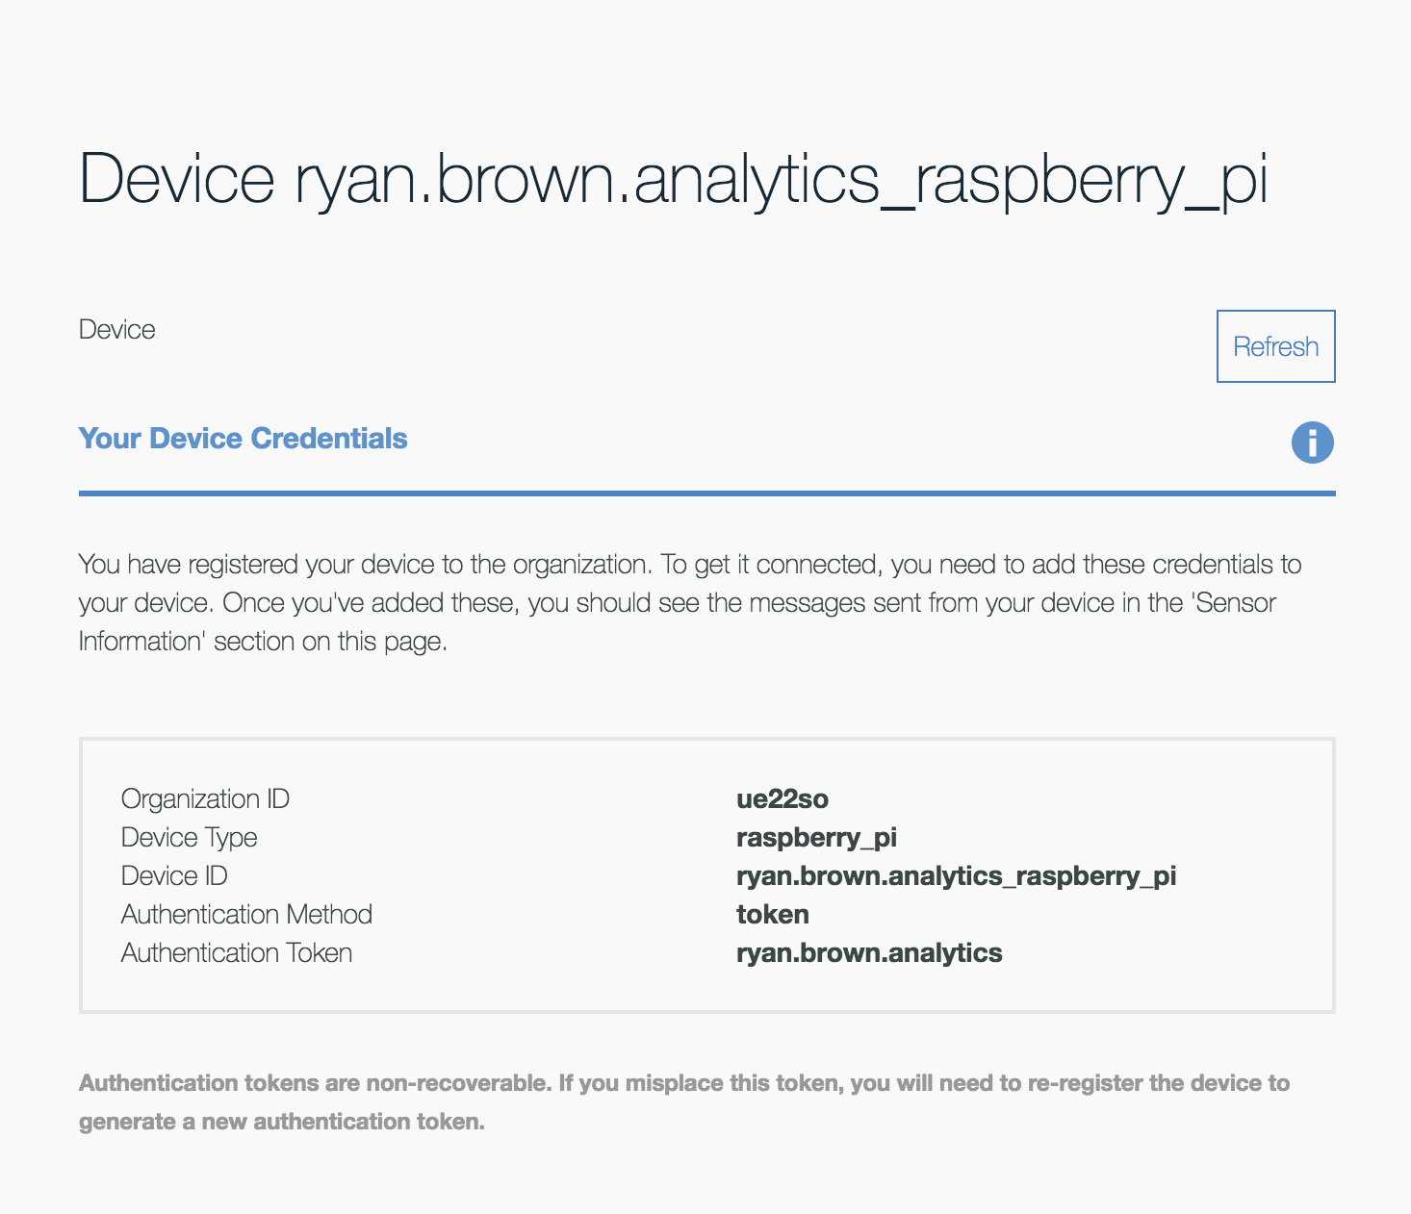

Slide 19
public static void main(String[] args) {
if (args.length == 0) {
throw new RuntimeException("input arg must be config file");
}
String configFileName = args[0];
DirectProvider provider = new DirectProvider();
Topology topology = provider.newTopology("RaspberryPiSensor");
IotDevice device = new IotpDevice(topology, new File(configFileName));
TStream<JsonObject> tStream = systemInfo(topology, 1, TimeUnit.SECONDS);
TStream<JsonObject> filteredStream = analyze(tStream)
device.events(filteredStream, "sensor", QoS.FIRE_AND_FORGET);
tStream.print();
provider.submit(topology);
}

Slide 20
static TStream<JsonObject> systemInfo(Topology topology, long period, TimeUnit unit) {
return topology.poll(() -> {
JsonObject piInfo = new JsonObject();
piInfo.addProperty("time", Instant.now().toString());
try {
piInfo.addProperty("cpuTemperature", SystemInfo.getCpuTemperature());
piInfo.addProperty("cpuVoltage", SystemInfo.getCpuVoltage());
} catch (Exception ex) {
throw new RuntimeException(ex);
}
return new Pair<>(piInfo, shouldSend);
}, period, unit);
}

Slide 21
Watson IoT Platform Demo

Slide 22
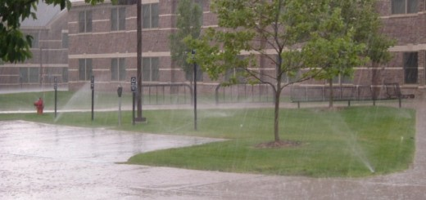

Slide 23
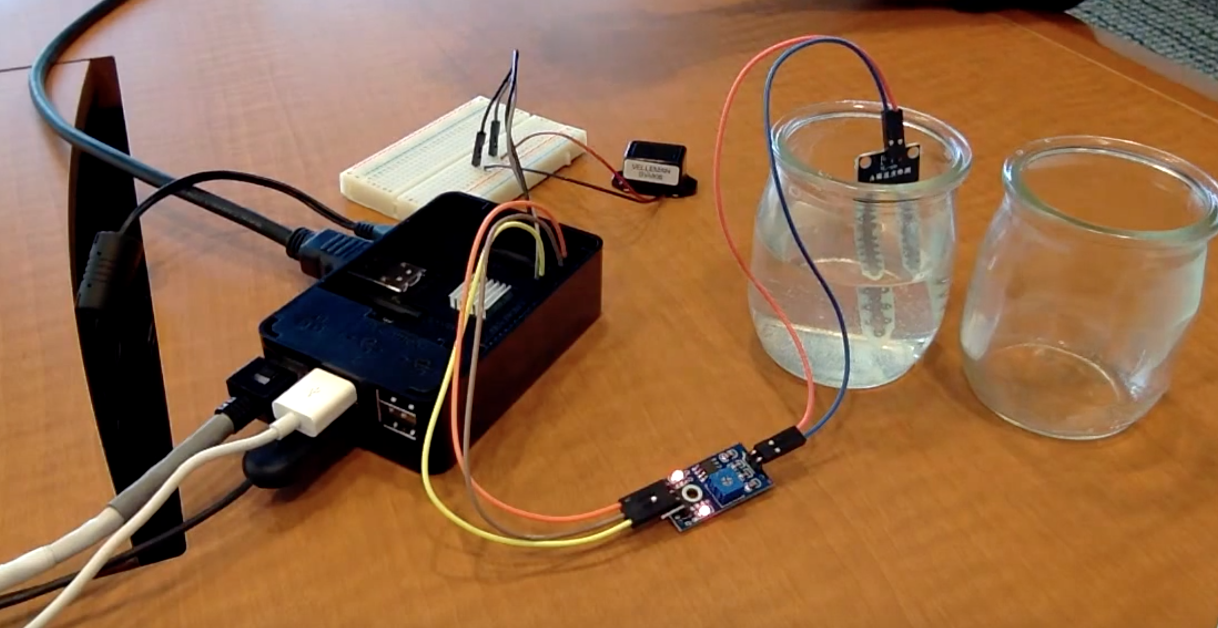

Slide 24
Sensor Data
Weather Data
Update Pi
x > Tm
Update Watson
Yes
No
No
x > Tw
Sprinkle
Yes

Slide 25
https://edgent.apache.org
Hangout: Intro to Apache Edgent Wednesday, April 13 10am-12pm PDT
Hangout: Apache Edgent on Raspberry Pi Thursday, May 12 10am-11am PDT
Big data and the Internet of Things: Two sides of the same coin? Tamara Dull, SAS Best Practices

